Slide 1

Data Science Capstone: Open an Indian Restaurant in Toronto

Slide 2
Overview
Toronto, the capital of the province of Ontario, is the most populous Canadian city.
More than half of the entire Indian Canadian population reside in Toronto
This makes it a great place to start an Indian restaurant.

Slide 3
Objective
Determine the most suitable location in Toronto to set up a new Indian restaurant. The parameters that will be examined are the demographics of each district and the number of pre-existing Indian restaurants in each area.
The criteria include the following:
- The number of ethnic Indians in each neighborhood or borough. The restaurant will be placed where there is a significant Indian community.
- Cannot be in same district where there at least 3 Indian restaurants.
- Opened in an area where there is a significant Indian population

Slide 4
Target Audience
Entrepreneurs or restaurateurs
Freelancers
Indian Community
People who love Indian food
Business Analysts or Data Scientists

Slide 5
Data
List of districts in Toronto, Canada
Latitude and Longitude of these districts
Geographic locations of Indian restaurants in districts. This will help us find neighborhoods that are more suitable to open an Indian Restaurant.
Indian population for each borough and neighborhood

Slide 6
Methodology
First, I need to get the list of districts in Toronto, Canada. This is possible by extracting the demographics for Toronto from Wikipedia page(https://www.toronto.ca/ext/open_data/catalog/data_set_files/2016_neighbourhood_profiles.csv ).
Next, I use Foursquare API to pull the list of top 100 venues within 500 meters radius. I have created a Foursquare developer account earlier in order to obtain an account ID and API key to pull the data.
Then using the Toronto Demographics file I gathered data on the ethnic population by boroughs, and neighborhoods.

Slide 7
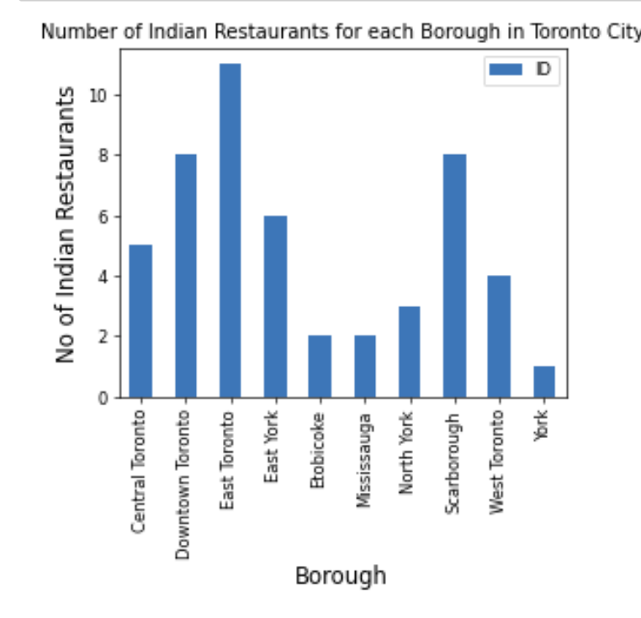
Analysis

Slide 8
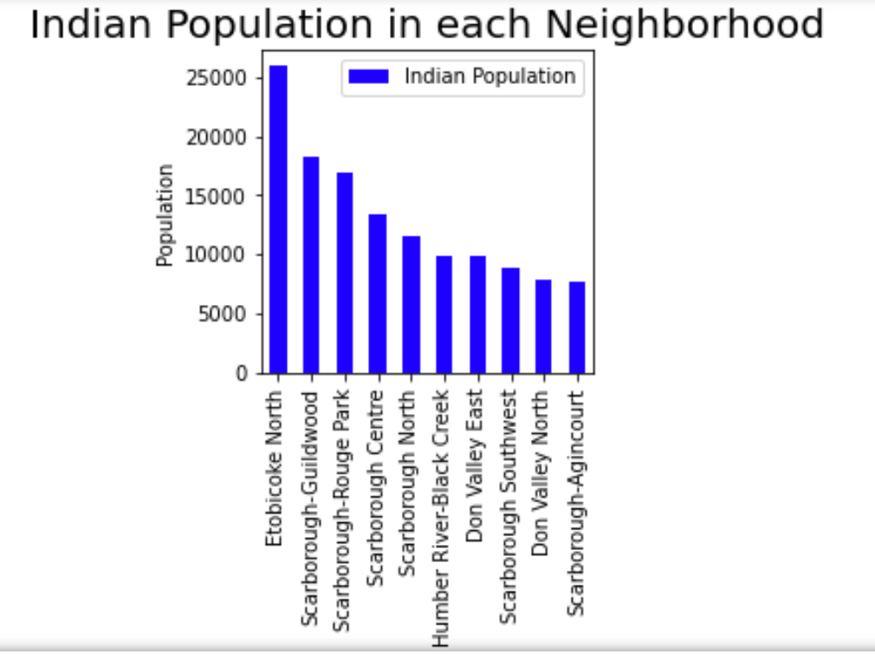
Analysis Cont…

Slide 9
Results
The highest concentration of Indian restaurants were found at these locations:
- Downtown Toronto
- Central Toronto
- East Toronto
The lowest concentration of Indian restaurants were found at these locations:
- Etobicoke
- York
- Missisauga

Slide 10
Conclusion
Largest concentrations of the Indian community reside in the following:
Etobicoke
Scarborough-Rouge Park
Scarborough-Guildwood.
They would be considered the top sites to set up a new Indian restaurant.

Slide 11
Discussion and Limitations
Do only Indians like Indian food? No
It is assumed in this project that only Indians like Indian foods
Indian food is popular
Other factors to consider
Rent
StartUp Costs
Nearby Indian Restaurant ratings

